Slide 1
Chapter 13: z/OS HTTP Server

Slide 2
Objectives
After reading this chapter, you will be able to:
  List the three server modes
  Explain static and dynamic Web pages
  List at least two functions from each of the following modes:
    Basic
    Security
    Caching
  Understand how to deploy a Web application on z/OS

Slide 3
Key terms in this chapter
CGI
dynamic
FRCA
HTTP
J2EE
LDAP
SSL
static

Slide 4
Introduction to Web applications on z/OS:
Past:
  Many applications are tied to z/OS (CICS, DB2)
  New developments made on other platforms
Now:
  Integrate both on z/OS
Notes:
As enterprises move many of their applications to the Web, mainframe organizations face
the complexity of enabling and managing new Web-based workloads in addition to more
traditional workloads, such as batch processing. This module and the next three show how
middleware products are used to supply the key functions needed to enable z/OS for
processing Web-based workloads.

Slide 5
z/OS HTTP Server
Server modes:
  Stand-alone server
  Scalable server
  Multiple servers
Static Web pages
Dynamic Web pages
Notes:
z/OS HTTP Server serves static and dynamic Web pages. HTTP Server has the same
capabilities as any other Web server, but it also has some features that are z/OS-specific.
You can run HTTP Server in any of three modes, with each offering advantages for
handling Web-based workloads:
Stand-alone server This mode is typically used for HTTP Server-only
implementations (simple Web sites). Its main role is to provide
a limited exposure to the Internet.
Scalable server This mode is typically used for interactive Web sites, where the
traffic volume increases or decline dynamically. It is intended
for a more sophisticated environment, in which servlets and
JSPs are invoked.
Multiple servers This mode uses a combination of stand-alone and scalable
servers to improve scalability and security throughout the
system. For example, a stand-alone server could be used as a
gateway to scalable servers, and the gateway could verify the
user authentication of all requests, and reroute requests to the
other servers.
With a Web server on z/OS, such as HTTP Server, the serving of static Web pages is
similar to Web servers on other platforms. The user sends an HTTP request to HTTP
Server to obtain a specific file. HTTP Server retrieves the file from its file repository and
sends it to the user, along with information about the file (such as mime type and size) in
the HTTP header.
Dynamic Web pages are an essential part of Web-based commerce. Every kind of
interaction and personalization requires dynamic content. When a user fills out a form on
a Web site, for example, the data in the form must be processed, and feedback must be
sent to the user.
Two approaches for serving dynamic Web pages on z/OS are:
Using CGI for dynamic Web pages
Using the plug-in interface

Slide 6
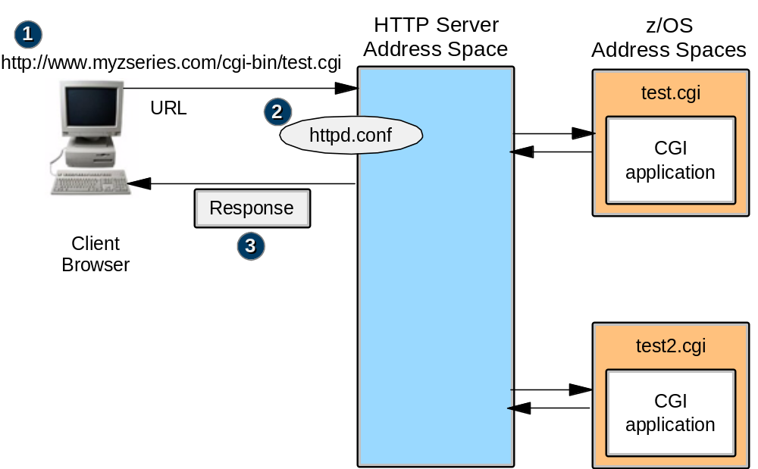
Dynamic Web Pages
Common Gateway Interface (CGI)
Notes:
One way to provide dynamic Web pages is through the Common Gateway Interface
(CGI), which is part of the HTTP protocol. CGI is a standard way for a Web server to
pass a Web user’s HTTP request to an application. GCI generates the output and passes it
back to HTTP Server, which sends it back to the user in an HTTP response, as shown on
the slide.
CGI has one major disadvantage, which is that each HTTP request requires a separate
address space. This causes a lack of efficiency when there are many requests at a time.
To avoid this problem, FastCGI was created. Basically, HTTP Server FastCGI plug-in is
a program that manages multiple CGI requests in a single address space, which saves
many program instructions for each request.

Slide 7
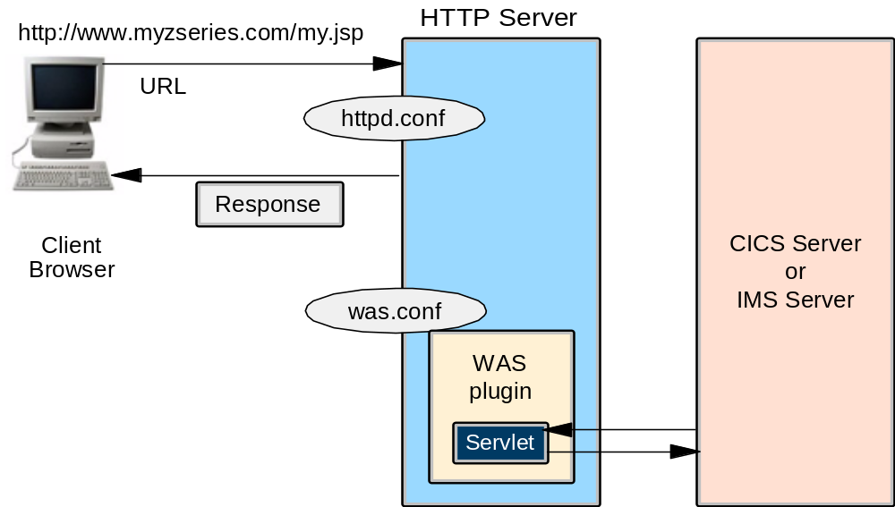
Dynamic Web Pages - Interaction with WebSphere
WebSphere plug-in, same address space
Notes:
Another way of providing dynamic content is by using the plug-in interface of HTTP
Server, which allows one of several products to interface with HTTP Server. Here, for
example, are some ways in which HTTP Server can pass control to WebSphere:
WebSphere plug-in, same address space. The slide shows a simple configuration in
which no J2EE server is needed. This servlet can connect to CICS or IMS, or to DB2
through JDBC. However, coding business logic inside servlets is not recommended.

Slide 8
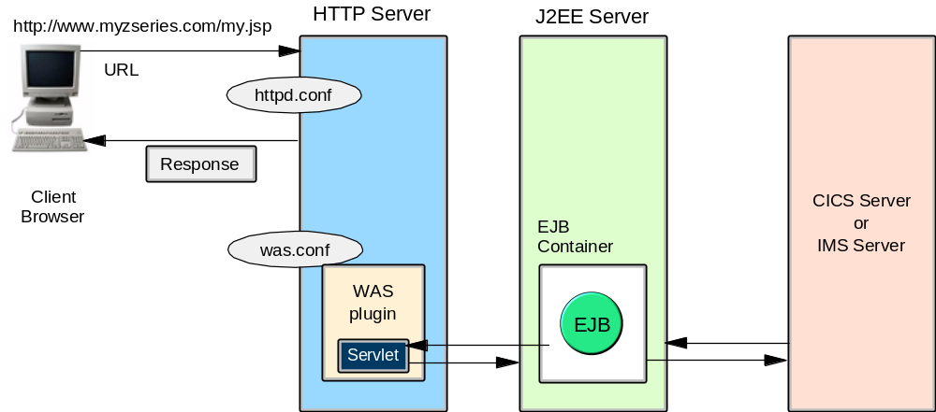
Dynamic Web Pages - Interaction with WebSphere
Web container inside HTTP Server, separate EJB container
Notes:
Web container inside HTTP Server, separate EJB container. This slide shows a
more usable configuration in which the servlets run in a different address space
than the EJBs, so the EJBs are invoked from remote calls. The EJBs then get
information from other servers.

Slide 9
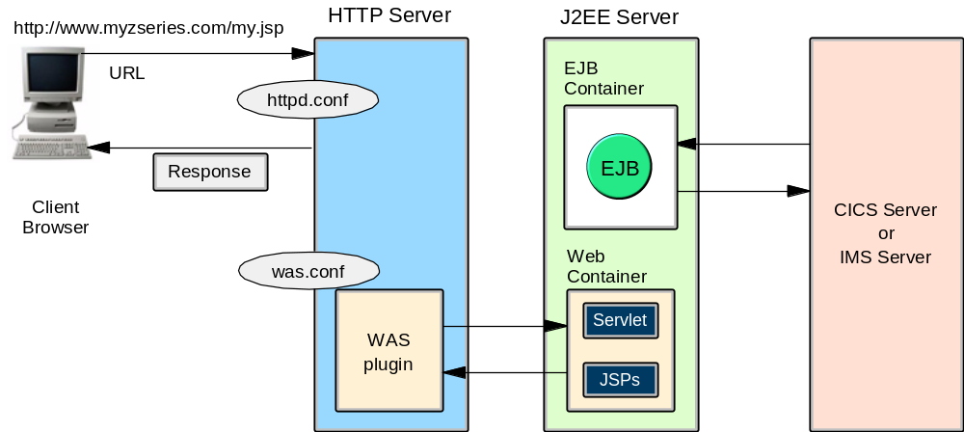
Dynamic Web Pages - Interaction with WebSphere
Separate J2EE server with both Web container and EJB container
Notes:
Separate J2EE server with both Web container and EJB container. In addition to
running your servlets locally within the WebSphere Plug-in, you can also use the
WebSphere plug-in to run servlets remotely in a Web container, as shown on
this slide.

Slide 10
HTTP server capabilities
Basic functions :
  EBCDIC/ASCII file access
  System Management Facilities
  Tracing & logging
  Server Side Includes
  Simple Network Management Protocol Management Information Base (SNMP MIB)
  Cookies support
  Multi Format Processing
  Persistent connections
  Virtual hosts
Notes:
EBCDIC/ASCII file access
The server accesses files and converts them, if needed, from EBCDIC to ASCII
encoding.
Performance and usage monitoring
As part of the z/OS features, HTTP Server can produce system management facilities
(SMF1) records that the system programmer can retrieve later to do performance and
usage analysis.
Tracing and logging
HTTP Server comes with a complete set of logging, tracing, and reporting
capabilities that allow you to keep track of every HTTP request.
Server side includes (SSI)
Server side includes allows you to insert information into documents (static or
dynamic) that the server sends to the clients. This could be a variable (like the “Last
modified” date), the output of a program, or the content of another file. Enabling this
function, but not using it, can have a serious performance impact.
Simple Network Management Protocol (SNMP) Management Information Base
(MIB)
HTTP Server provides an SNMP MIB and SNMP subagent, so you can use any
SNMP-capable network management system to monitor your server’s health,
throughput, and activity. It can then notify you if specified threshold values are
exceeded.
Cookies support
Because HTTP is a stateless protocol, a state can be added with the help of cookies,
which store information on the client’s side. This support is useful for multiple Web
pages, for example to achieve customized documents or for banner rotation.
Multi-Format Processing
This feature is used for personalization of Web pages. The browser sends header
information along with the request, including the accept header. This information
includes the language of the user. HTTP Server can make use of the contents of the
accept header to select the appropriate document to return to the client.
Persistent connections
With the help of this HTTP/1.1-specific feature, not every request has to establish a
new connection. Persistent connections stay “alive” for a certain amount of time to
enable the use of a given connection to another request.
Virtual hosts
Virtual hosts allow you to run one Web server while making it appear to clients as if
you are running several. This is achieved by the use of different DNS names for the
same IP and/or different IP addresses bound to the same HTTP Server.

Slide 11
HTTP server capabilities (continued)
Security functions:
  Thread level security
  HTTPS/SSL support
  LDAP support
  Certificate authentication
  Proxy support
Notes:
Thread level security
An independent security environment can be set for each thread running under HTTP
Server, which basically means that every client connecting to the server will have its
own security environment.
HTTPS/SSL support
HTTP Server has full support for the Secure Socket Layer (SSL) protocol. HTTPS
uses SSL as a sub-layer under the regular HTTP layer to encrypt and decrypt HTTP
requests and HTTP responses. HTTPS uses port 443 for serving instead of HTTP port
80.
LDAP support
The Lightweight Data Access Protocol (LDAP) specifies a simplified way to retrieve
information from an X.500-compliant directory in an asynchronous, client/server
type of protocol
Certificate authentication
As part of the SSL support, HTTP Server can use certificate authentication and act as
a certificate authority.
Proxy support
HTTP Server can act as a proxy server. You cannot, however, use the Fast Response
Cache Accelerator (FRCA).

Slide 12
HTTP server capabilities (continued)
File caching:
  HTTP server caching HFS files
  HTTP server caching z/OS data sets
  Unix System Service caching HFS files
  Fast Response Cache Accelerator (FRCA)
Notes:
Performance can be significantly increased by using any of the following file caching
(buffering) possibilities:
HTTP Server caching HFS files
HTTP Server caching z/OS data sets
z/OS UNIX caching HFS files
Fast Response Cache Accelerator (FRCA)

Slide 13
Summary
In this chapter, you learned about:
  The three server modes
  Static and dynamic Web pages
  These HTTP server modes:
    Basic
    Security
    Caching
  Deploying a Web application on z/OS

